Slide 1
B.Tech Integrated Mid-Term Presentation
A.Y. 2021-2022 Project Title: Disease Prediction System using Machine Learning
Presented by: Vaibhav Raheja (C056)
Viraj Shah (C064)
Mayank Shetty (C075)
Purav Patel (C098)
Under The Guidance of: Prof. Manisha Tiwari

Slide 2
Roadmap
Introduction
Literature Review
Proposed System
Architecture Diagram
Implementation (To Date)
Plan of Action
References

Slide 3
Introduction
Chronic diseases last for a period of 1 year or more, and are caused by environmental, genetic, and physiological factors.
Cardiovascular Disease is the leading cause of death globally, claiming an estimated 17.9 million lives in 2019 alone.
Respiratory disease, diabetes, and kidney diseases are included in the global list of top ten leading causes of death.
Early diagnosis of these chronic diseases may save several lives.

Slide 4
Literature Review
Link for Literature Review

Slide 5
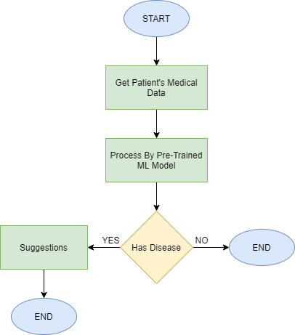
Proposed System
Chronic Disease | Dataset
Chronic Kidney Disease | UCI Chronic Kidney Disease Dataset
Diabetes | PIMA Indians Diabetes Database
Heart Ailments | UCI Heart Disease Dataset
Pneumonia | Dataset for Chest X Ray

Slide 6
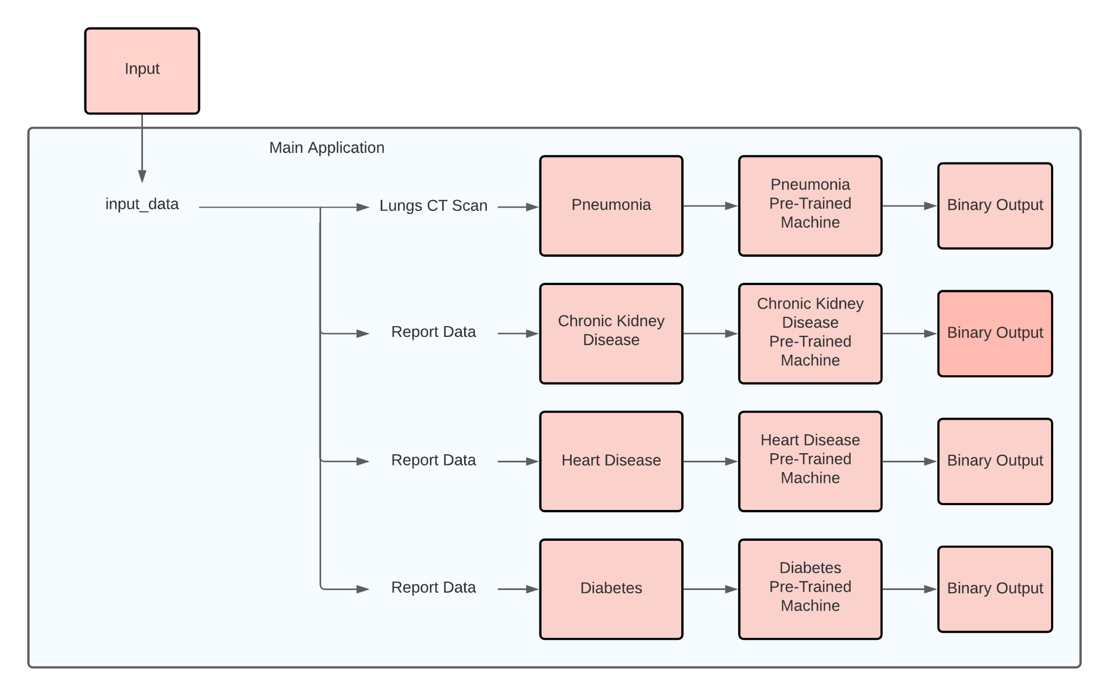
Architecture Diagram

Slide 7
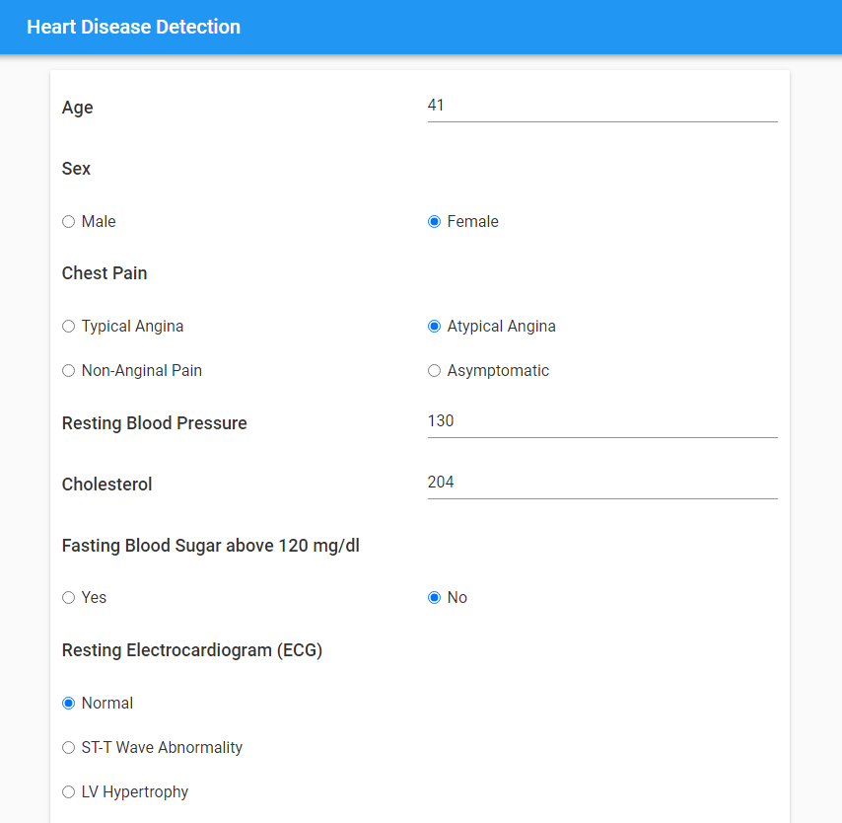
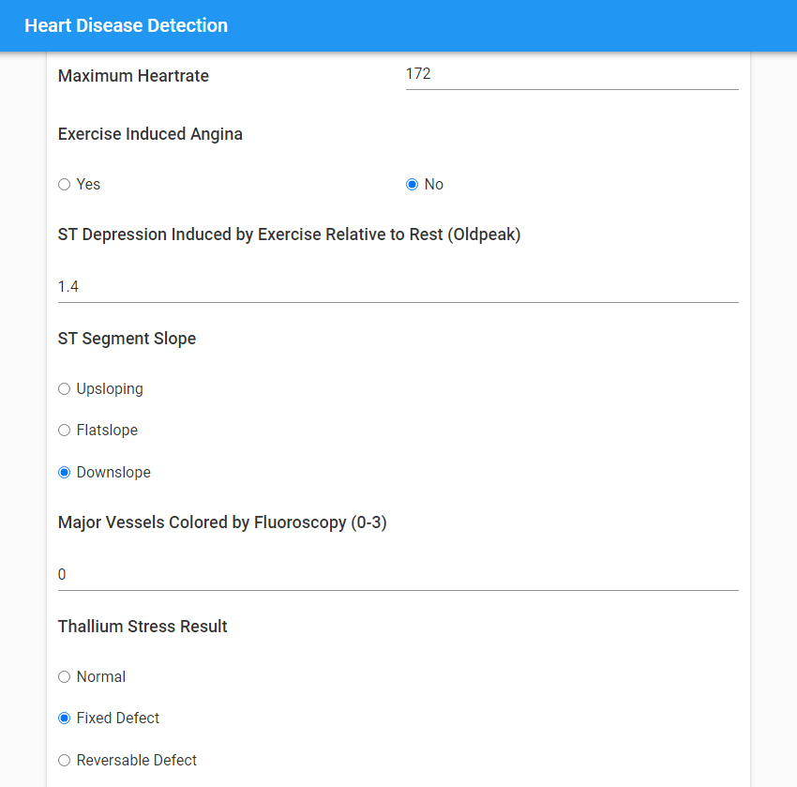
Implementation (To Date)
Input parameters for Heart Disease Detection

Slide 8
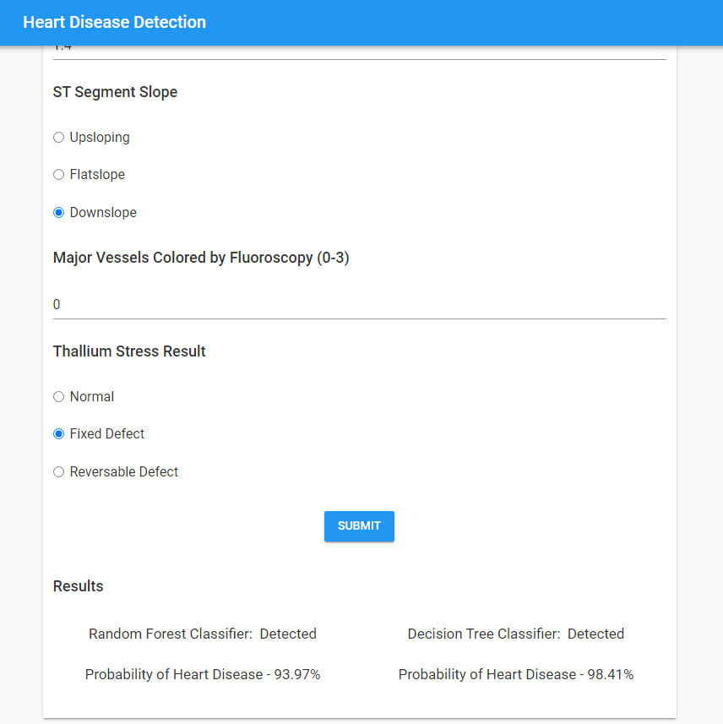
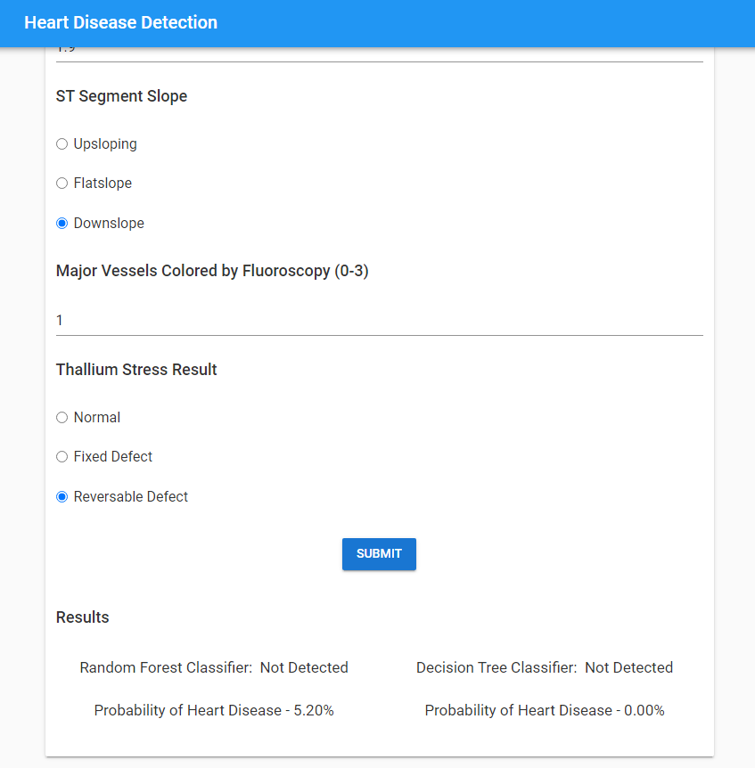
Implementation (To Date)
Heart Disease detected by both classifiers
Heart Disease not detected by both classifiers

Slide 9
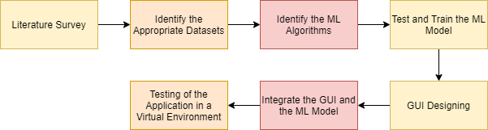
Plan of Action

Slide 10
References
[1] J. J. Khanam, S. Y. Foo, “A comparison of machine learning algorithms for diabetes prediction”, ICT Express (Feb. 2021), 2021, doi: 10.1016/J.ICTE.2021.02.004.
[2] D. Shetty, K. Rit, S. Shaikh and N. Patil, "Diabetes disease prediction using data mining," 2017 International Conference on Innovations in Information, Embedded and Communication Systems (ICIIECS), 2017, pp. 1-5, doi: 10.1109/ICIIECS.2017.8276012.
[3] A. Mujumdar, V. Vaidehi, “Diabetes Prediction using Machine Learning Algorithms”, Procedia Computer Science, Volume 165, 2019, pp. 292-299, doi: 10.1016/J.PROCS.2020.01.047.
[4] S. K. Dey, A. Hossain and M. M. Rahman, "Implementation of a Web Application to Predict Diabetes Disease: An Approach Using Machine Learning Algorithm," 2018 21st International Conference of Computer and Information Technology (ICCIT), 2018, pp. 1-5, doi: 10.1109/ICCITECHN.2018.8631968.
[5] M. Kavitha, G. Gnaneswar, R. Dinesh, Y. R. Sai and R. S. Suraj, "Heart Disease Prediction using Hybrid Machine Learning Model," 2021 6th International Conference on Inventive Computation Technologies (ICICT), 2021, pp. 1329-1333, doi: 10.1109/ICICT50816.2021.9358597.
[6] F. Alotaibi, “Implementation of Machine Learning Model to Predict Heart Failure Disease”, International Journal of Advanced Computer Science and Applications (IJACSA), 10(6), 2019, doi: 10.14569/IJACSA.2019.0100637.
[7] J. Qin, L. Chen, Y. Liu, C. Liu, C. Feng and B. Chen, "A Machine Learning Methodology for Diagnosing Chronic Kidney Disease," in IEEE Access, vol. 8, pp. 20991-21002, 2020, doi: 10.1109/ACCESS.2019.2963053.
[8] R. Gupta, N. Koli, N. Mahor and N. Tejashri, "Performance Analysis of Machine Learning Classifier for Predicting Chronic Kidney Disease," 2020 International Conference for Emerging Technology (INCET), 2020, pp. 1-4, doi: 10.1109/INCET49848.2020.9154147.
[9] F. M. Javed Mehedi Shamrat, P. Ghosh, M. H. Sadek, M. A. Kazi and S. Shultana, "Implementation of Machine Learning Algorithms to Detect the Prognosis Rate of Kidney Disease," 2020 IEEE International Conference for Innovation in Technology (INOCON), 2020, pp. 1-7, doi: 10.1109/INOCON50539.2020.9298026.
[10] D. Varshni, K. Thakral, L. Agarwal, R. Nijhawan and A. Mittal, "Pneumonia Detection Using CNN based Feature Extraction," 2019 IEEE International Conference on Electrical, Computer and Communication Technologies (ICECCT), 2019, pp. 1-7, doi: 10.1109/ICECCT.2019.8869364. [11] A. Sharma, M. Negi, A. Goyal, R. Jain and P. Nagrath, “Detection of Pneumonia using ML & DL in Python.”, IOP Conference Series: Materials Science and Engineering 1022, 2021, doi: 10.1088/1757-899X/1022/1/012066.

